Slide 1
Lab 3 c
Dr : Ghada
Eng : Somaya
Eng Gehad Mustafa

Slide 2
contents
Loops
While Loop
For Loop
Do While Loop
Nested Loops
Loop Control Statements
Tasks

Slide 3
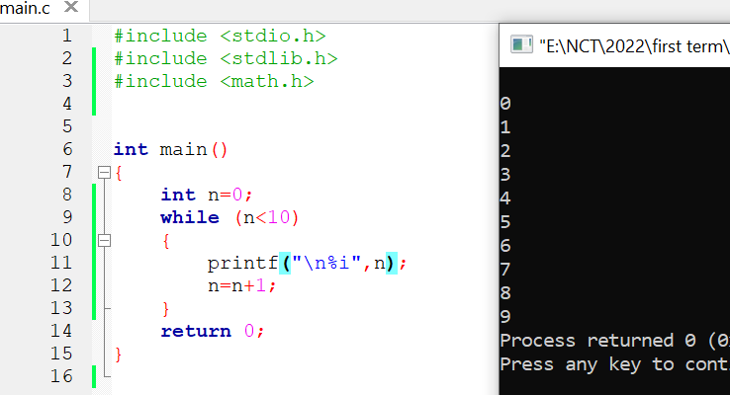
While Loop

Slide 4
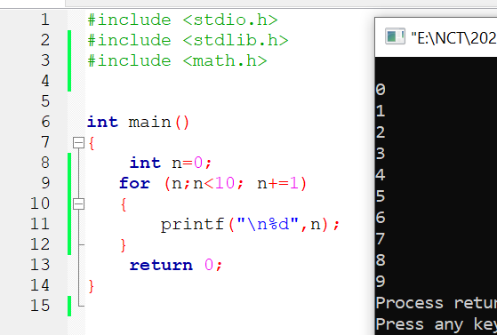
For Loop

Slide 5
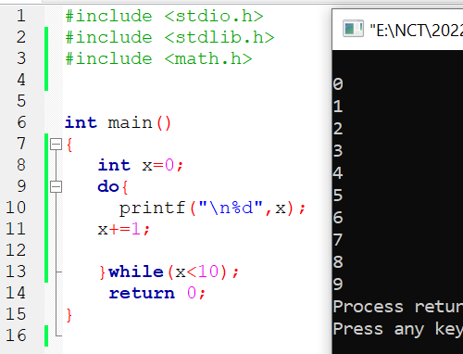
Do While

Slide 6
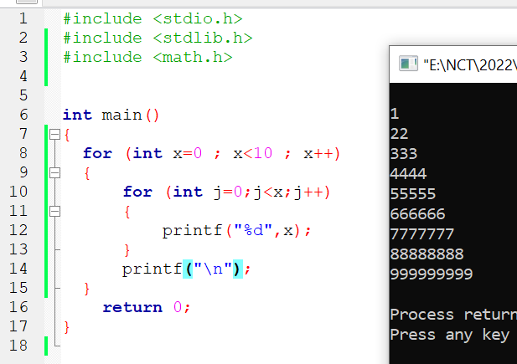
Nested Loop

Slide 7
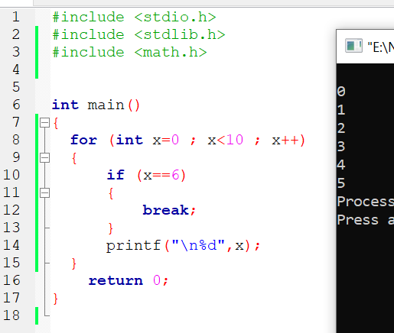
Break

Slide 8
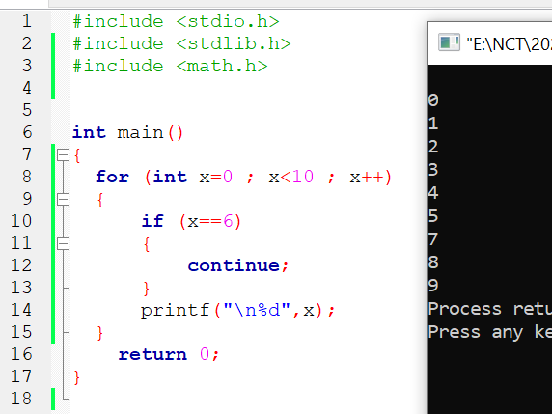
Continue

Slide 9
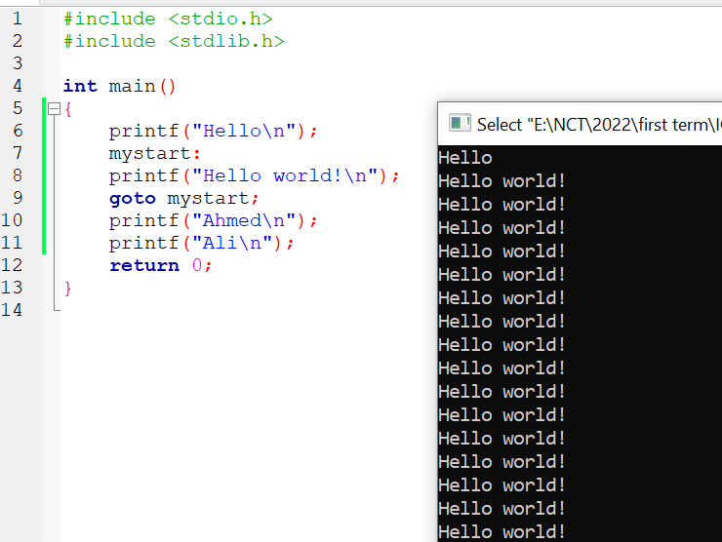
Goto

Slide 10
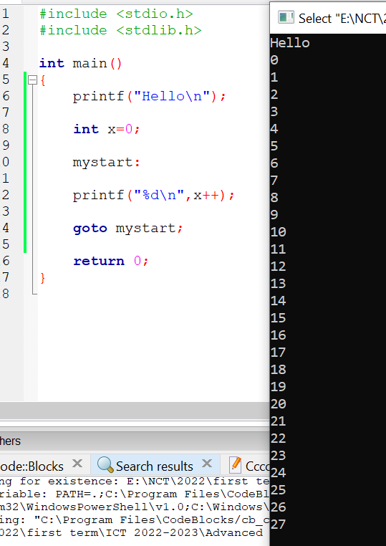
goto

Slide 11
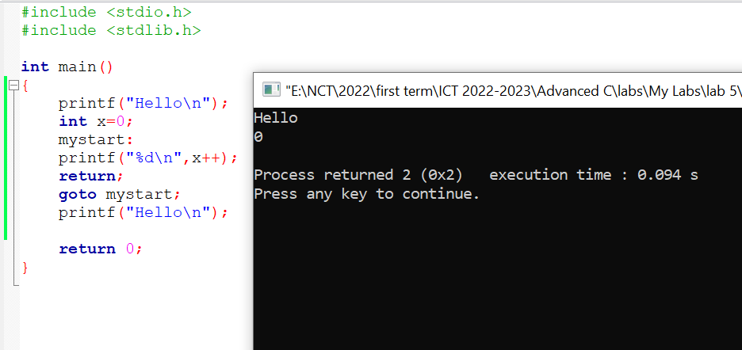
Goto (return)

Slide 12
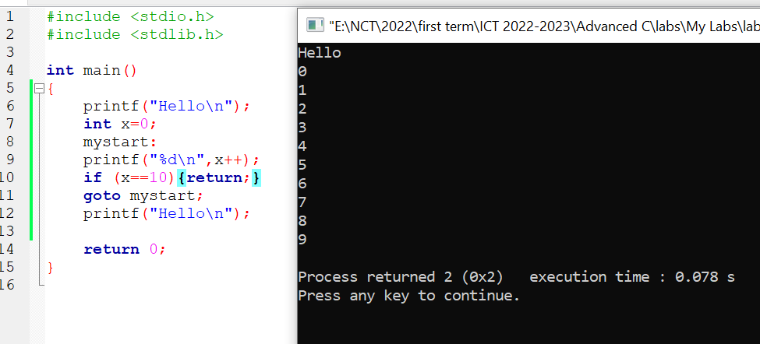
Goto (return)

Slide 13
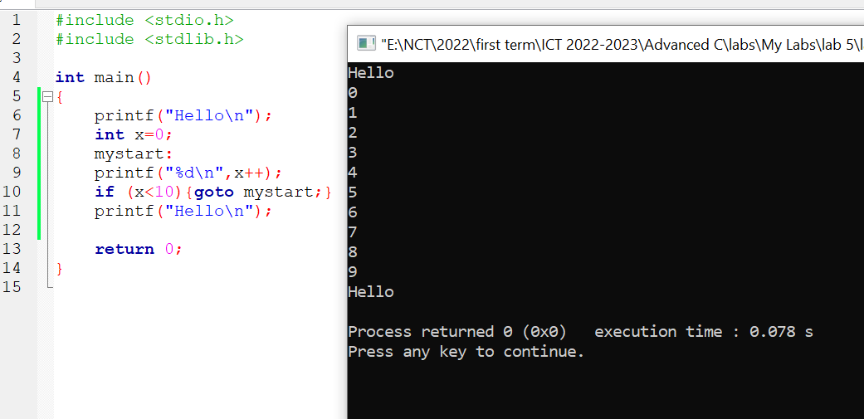
Goto

Slide 14
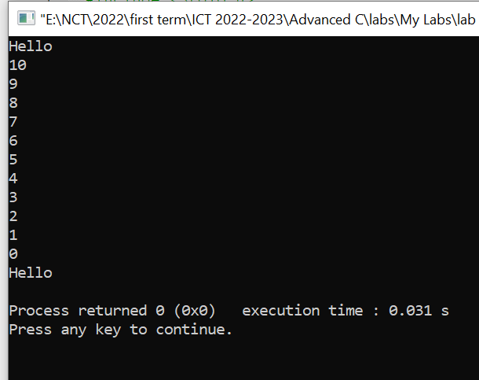
Try
Print from 10 to 0 by using Goto!

Slide 15
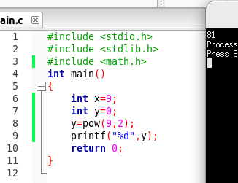
Power

Slide 16
Tasks
Write the program to print the following:
1, -1, 1, -1, 1, -1, 1, -1,............
Write a code to calculate the following:
1, 9, 125, 216, 343,……………
Try to calculate the power P of a number N.

Slide 17
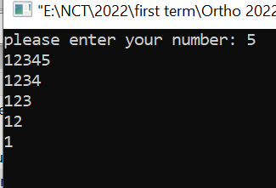
Tasks
Write the code to print the following:

Slide 18
